Slide 1
Numerical problem of Amalgamation of partnership firms
Mrs. Meenakshi
Assistant Professor
Kanya Mahavidyalaya Kharkhoda

Slide 2
Problem 1
The following are the balance sheets of M/S A&B and M/S X&Y as at April 1, 2014 :
Liabilities | A & B | X & Y | Assets | A & B | X & Y
Bills Payable Creditors General Reserve Capital A/C s A ----- B ----- X----- Y------ | 10,800 22,000 7,200 30,000 30,000 1,00,000 | 16,000 15,000 5,400 50,000 45,000 1,31,400 | Land & Building Plant & Machinery Furniture Bills Receivable Stock Debtors Goodwill Investments Cash at Bank | 36,000 20,000 5,000 6,600 10,000 12,000 8,000 ------ 2,400 1,00,000 | 45,000 25,000 7,500 4,500 15,000 16,000 ------ 15,000 3,400 1,31,400

Slide 3
Continue…
A & B are equal partners and X & Y were sharing profits & losses in the ratio of 2:1. The two firms decided to amalgamate their business on April 1, 2014. The Profit sharing ratio was to be A 1/6,B 2/6, X 2/6 and Y 1/6 (1:2:2:1).The other terms were:
The stock of A&B was appreciated by 10% and that of X&Y depreciated by 10%.
Investments of X&Y were not to be taken over by the new firm but were to be distributed among X&Y in their profit sharing ratio.
Furniture of A&B was valued at Rs. 3,400 and X&Y at Rs. 6,500.
Plant & Machinery of A&B was to be depreciated by 15%.
A provision of 5% be created for doubtful debts on debtors of both the firms.
Land & Building of A&B be appreciated by 20% and that of X&Y are appreciated by 10%.

Slide 4
Continue….
Goodwill of A&B and X&Y were valued at Rs. 18,000 and Rs. 12,000 respectively. The new firm was not to retain goodwill in the books.
The new firm was styled as A,B,X &Y. The total capital of the new firm was fixed at Rs.1,50,000 to be contributed by the partners in their profit sharing ratio. The adjustments were to be made in cash.
Pass the journal Entries to close the books of the two firms and to open the books of the new firm. Also prepare the balance sheet of the new firm.

Slide 5
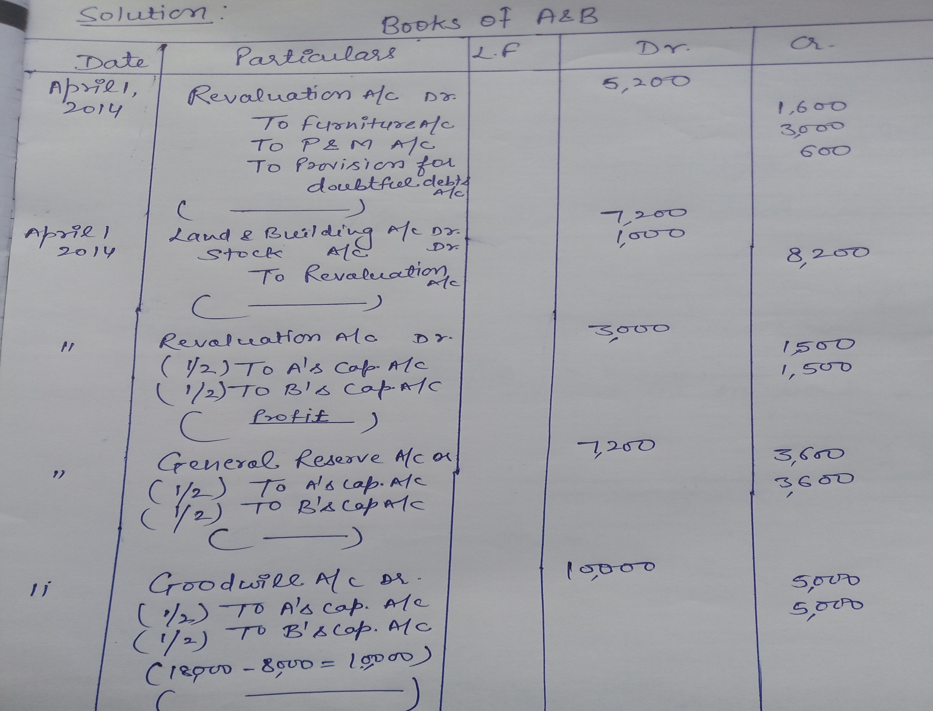

Slide 6
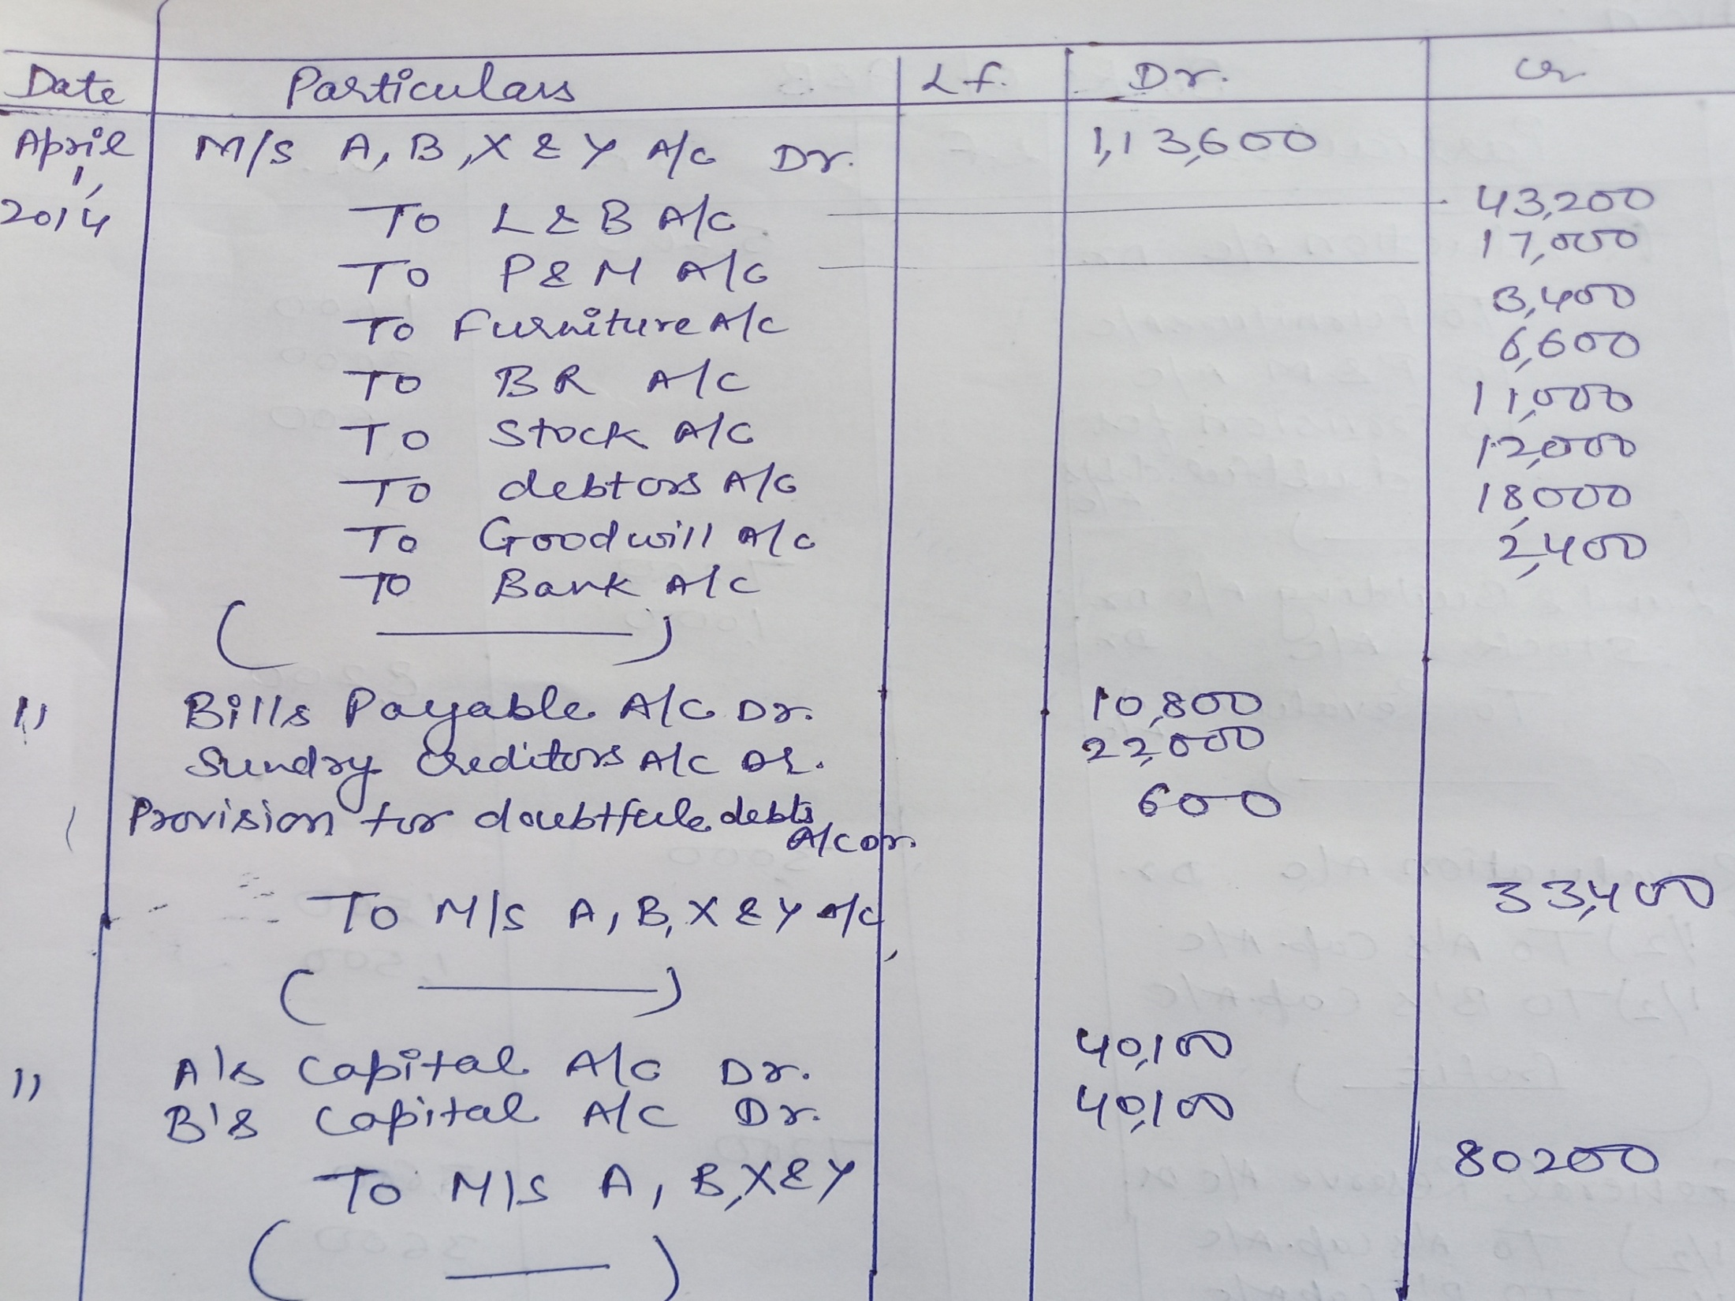

Slide 7
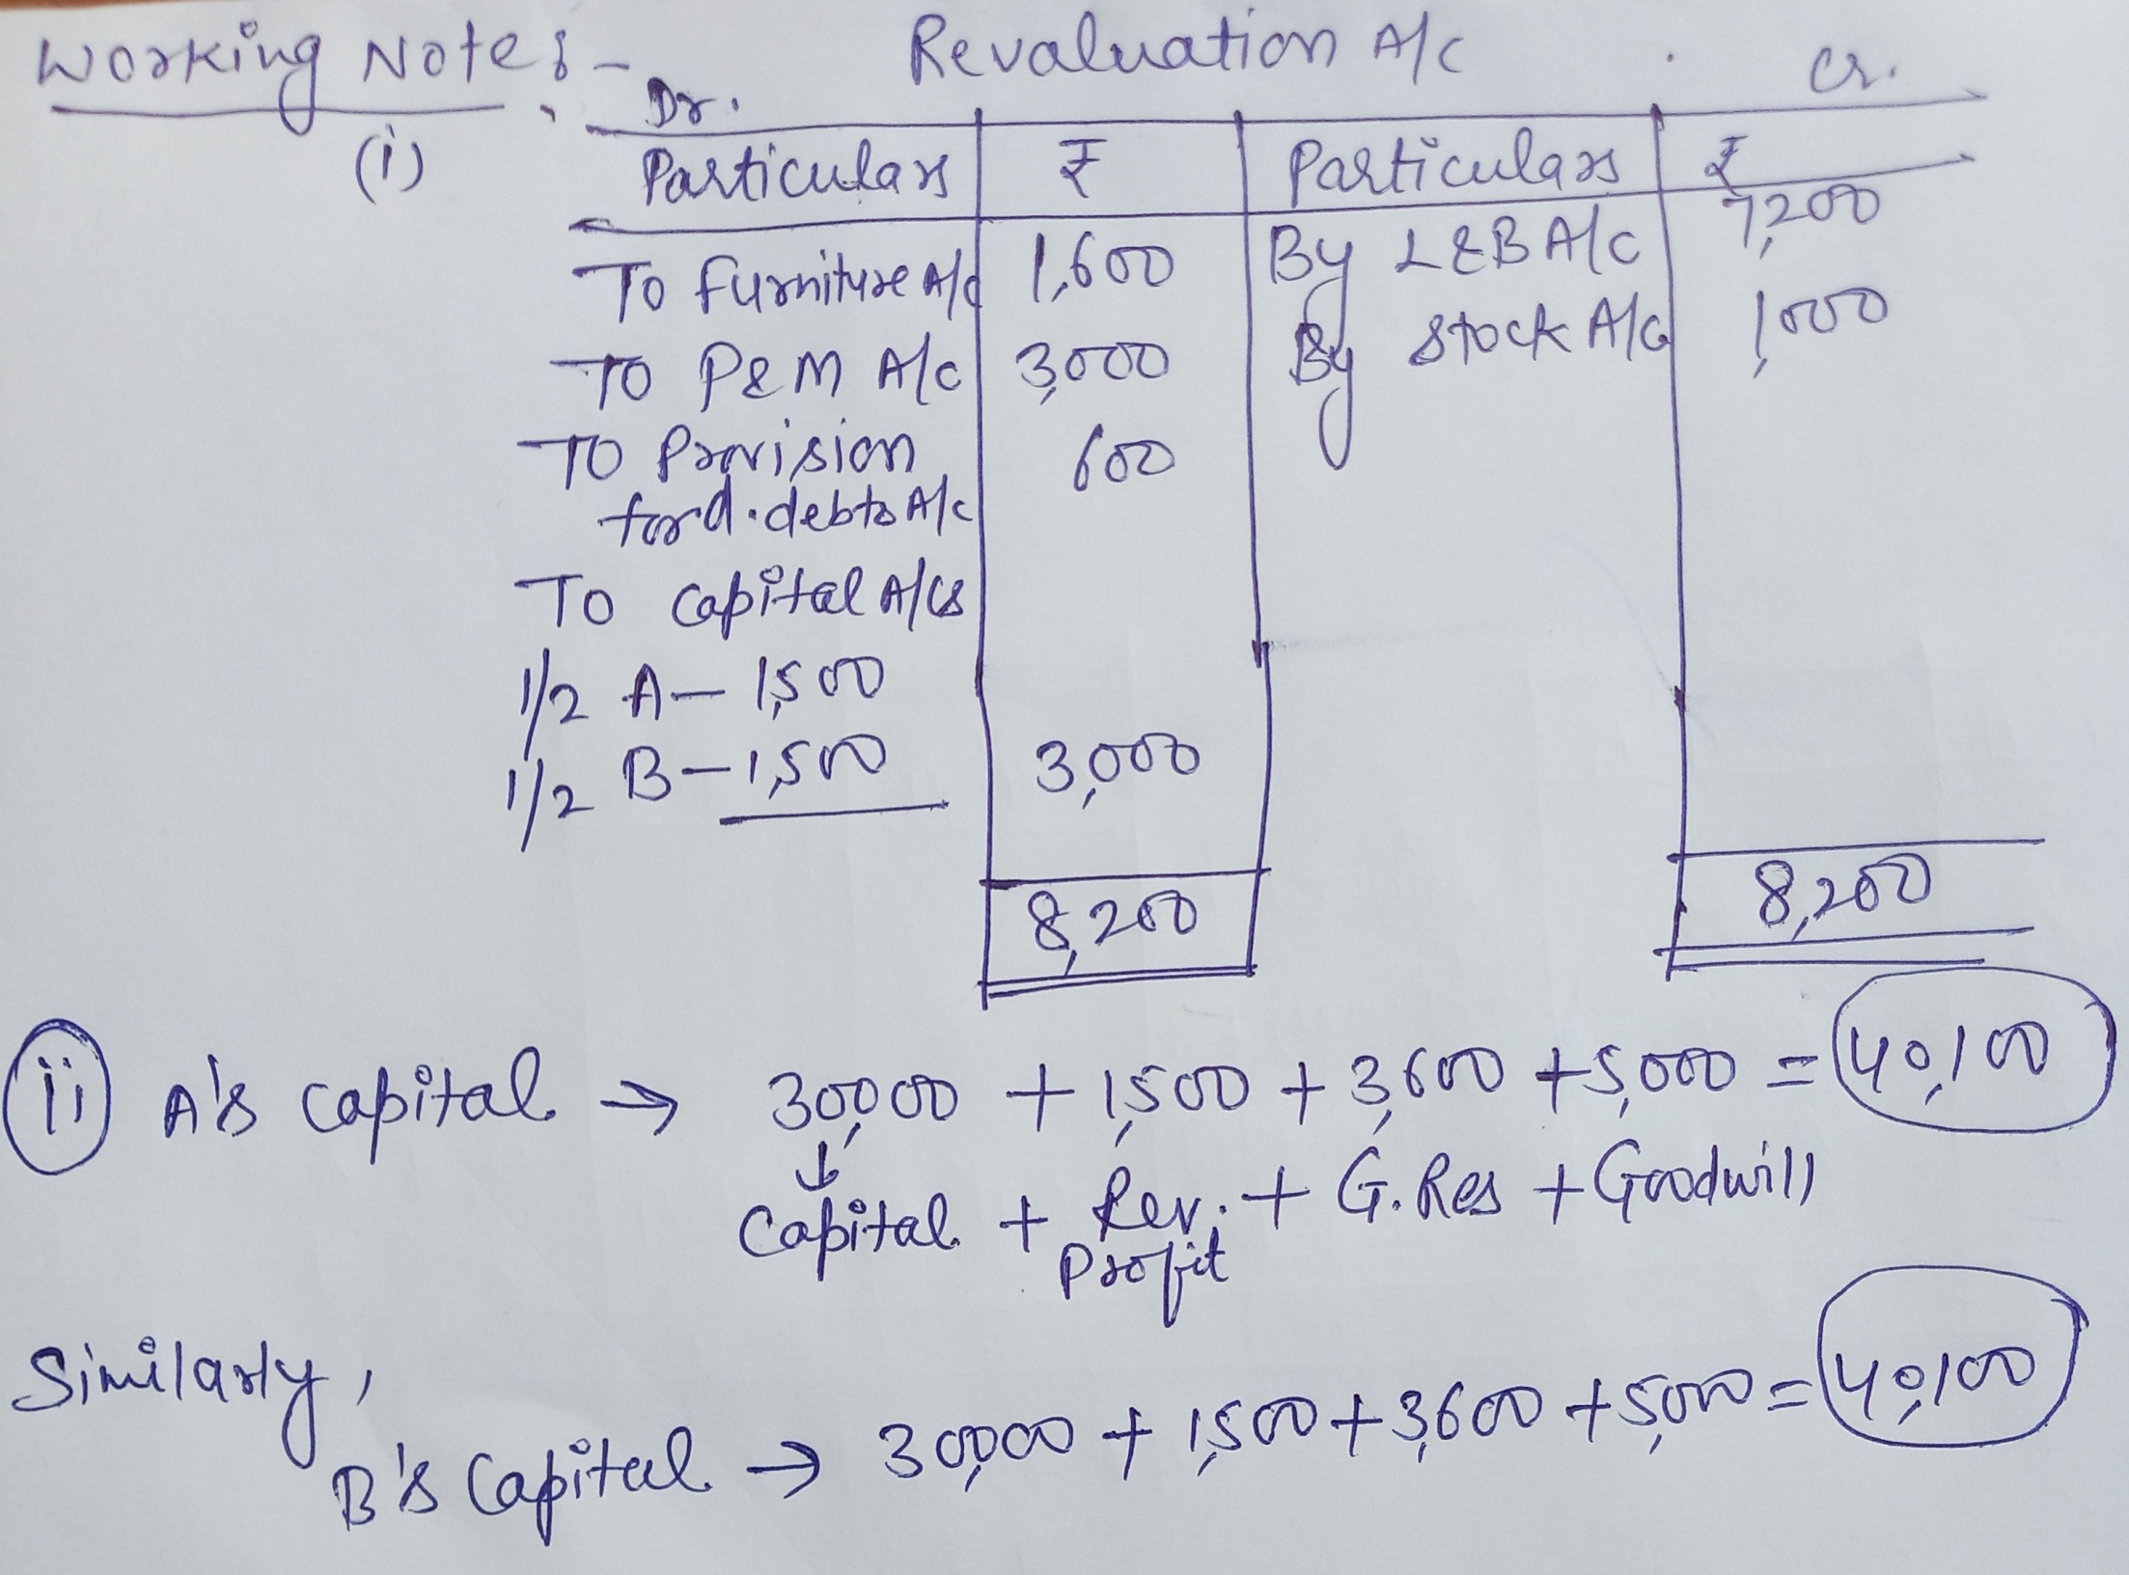

Slide 8
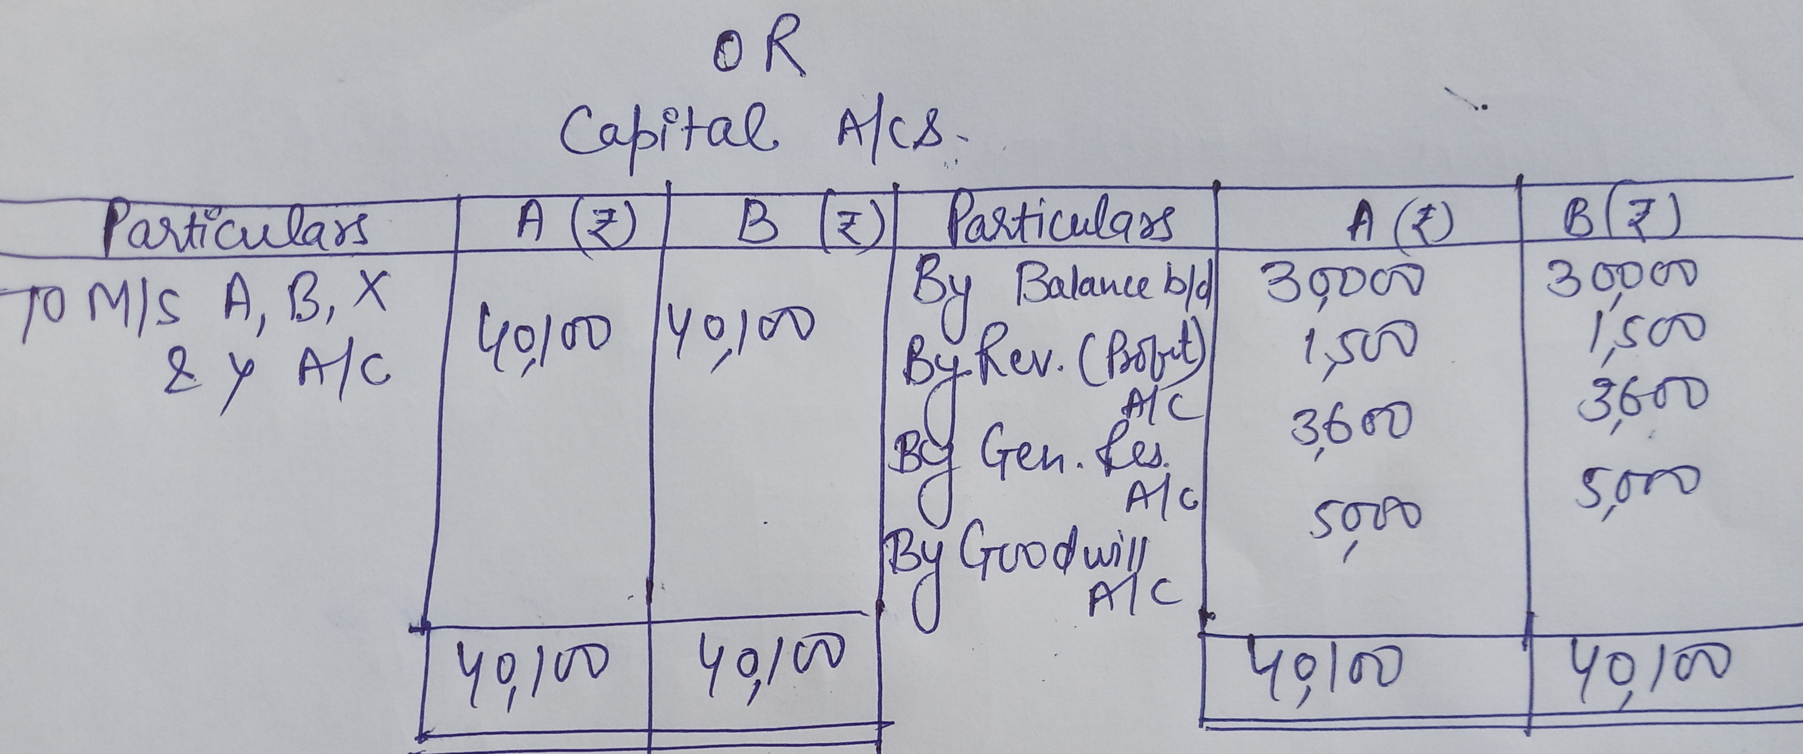

Slide 9
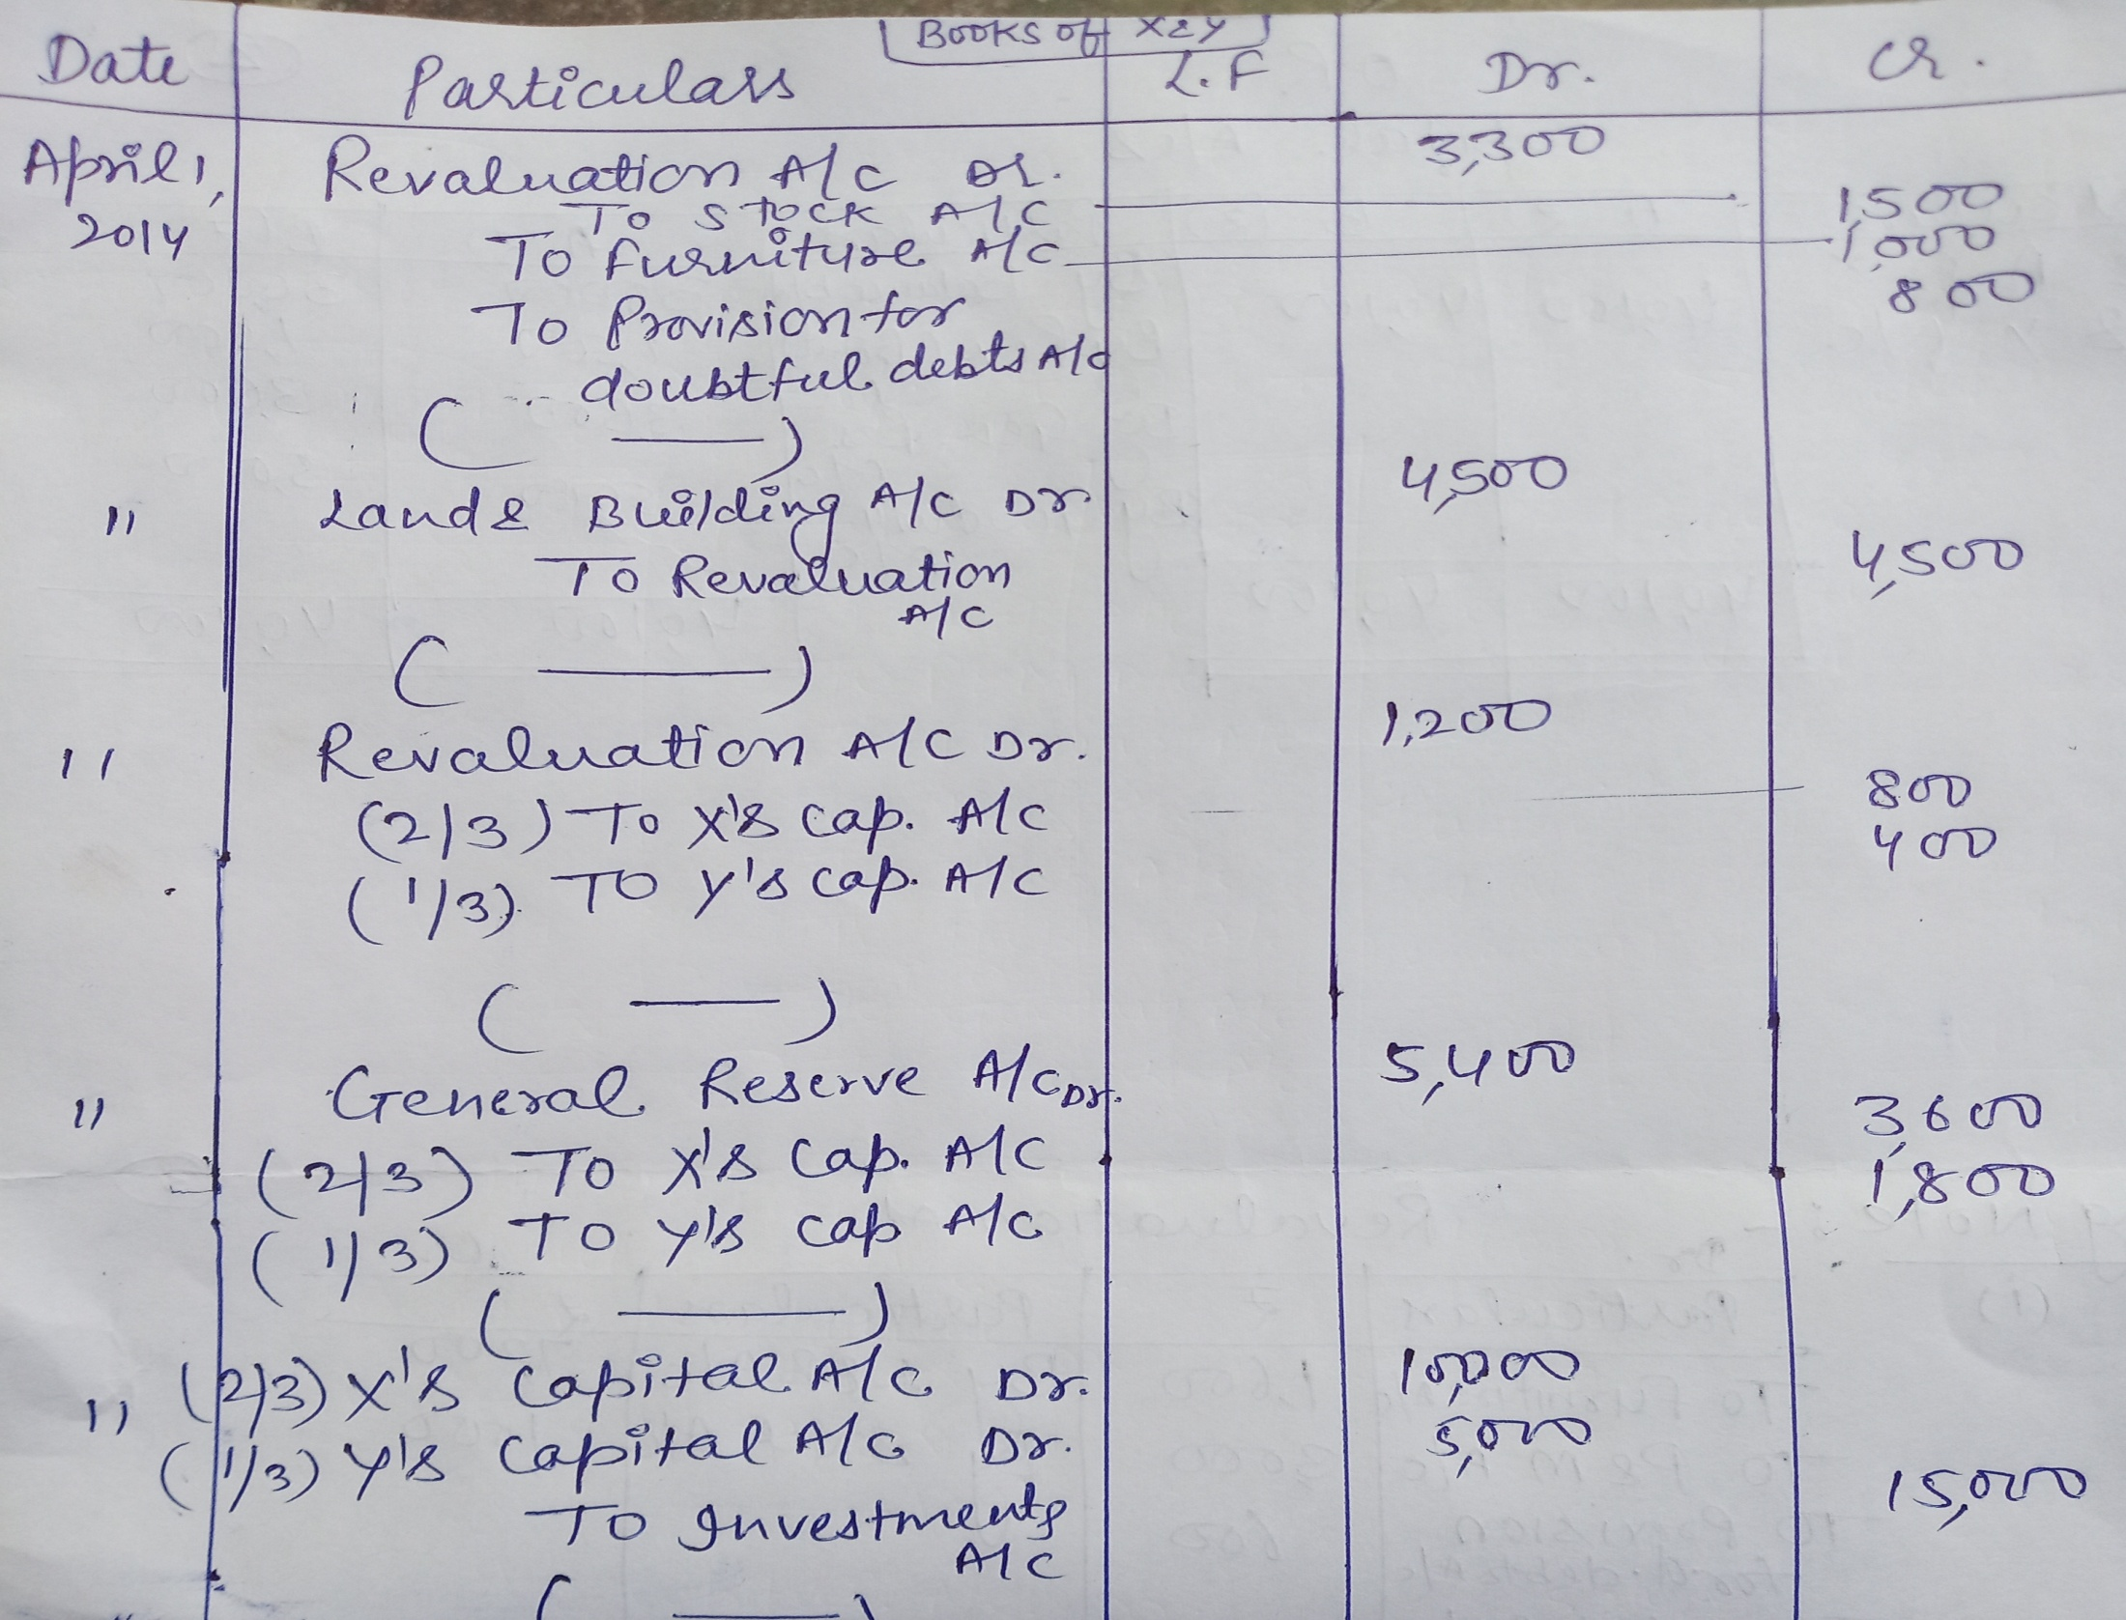

Slide 10
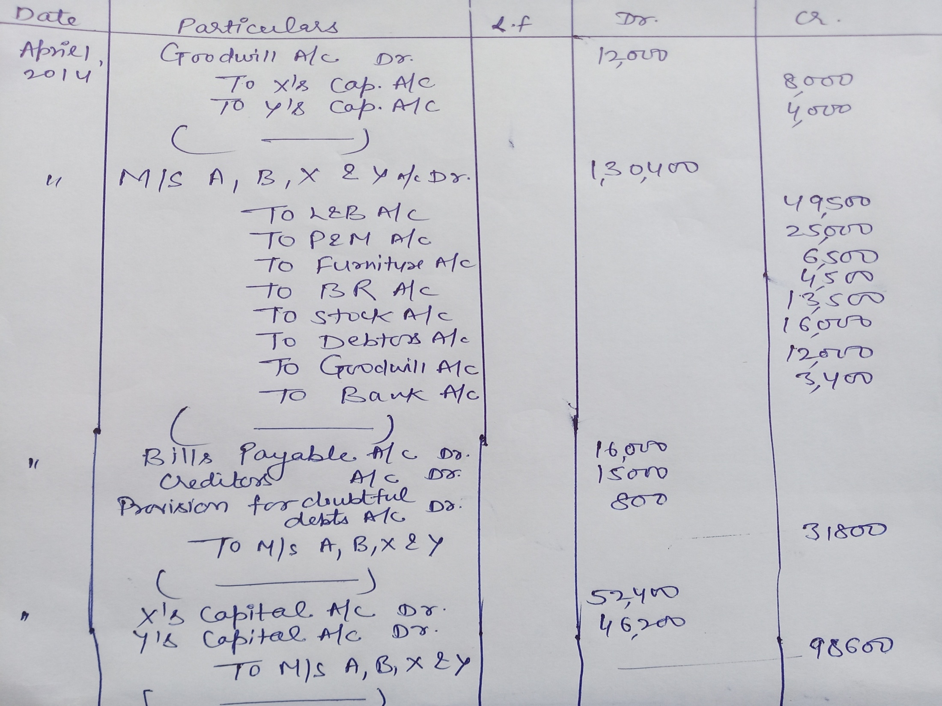

Slide 11
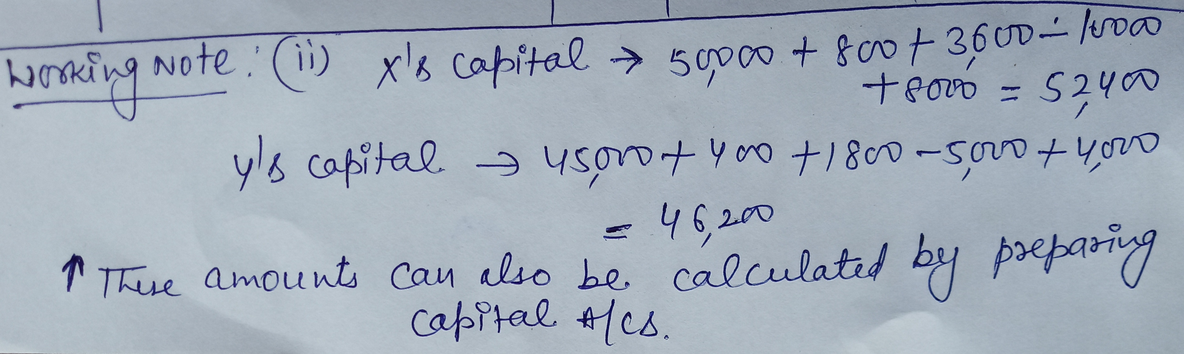

Slide 12
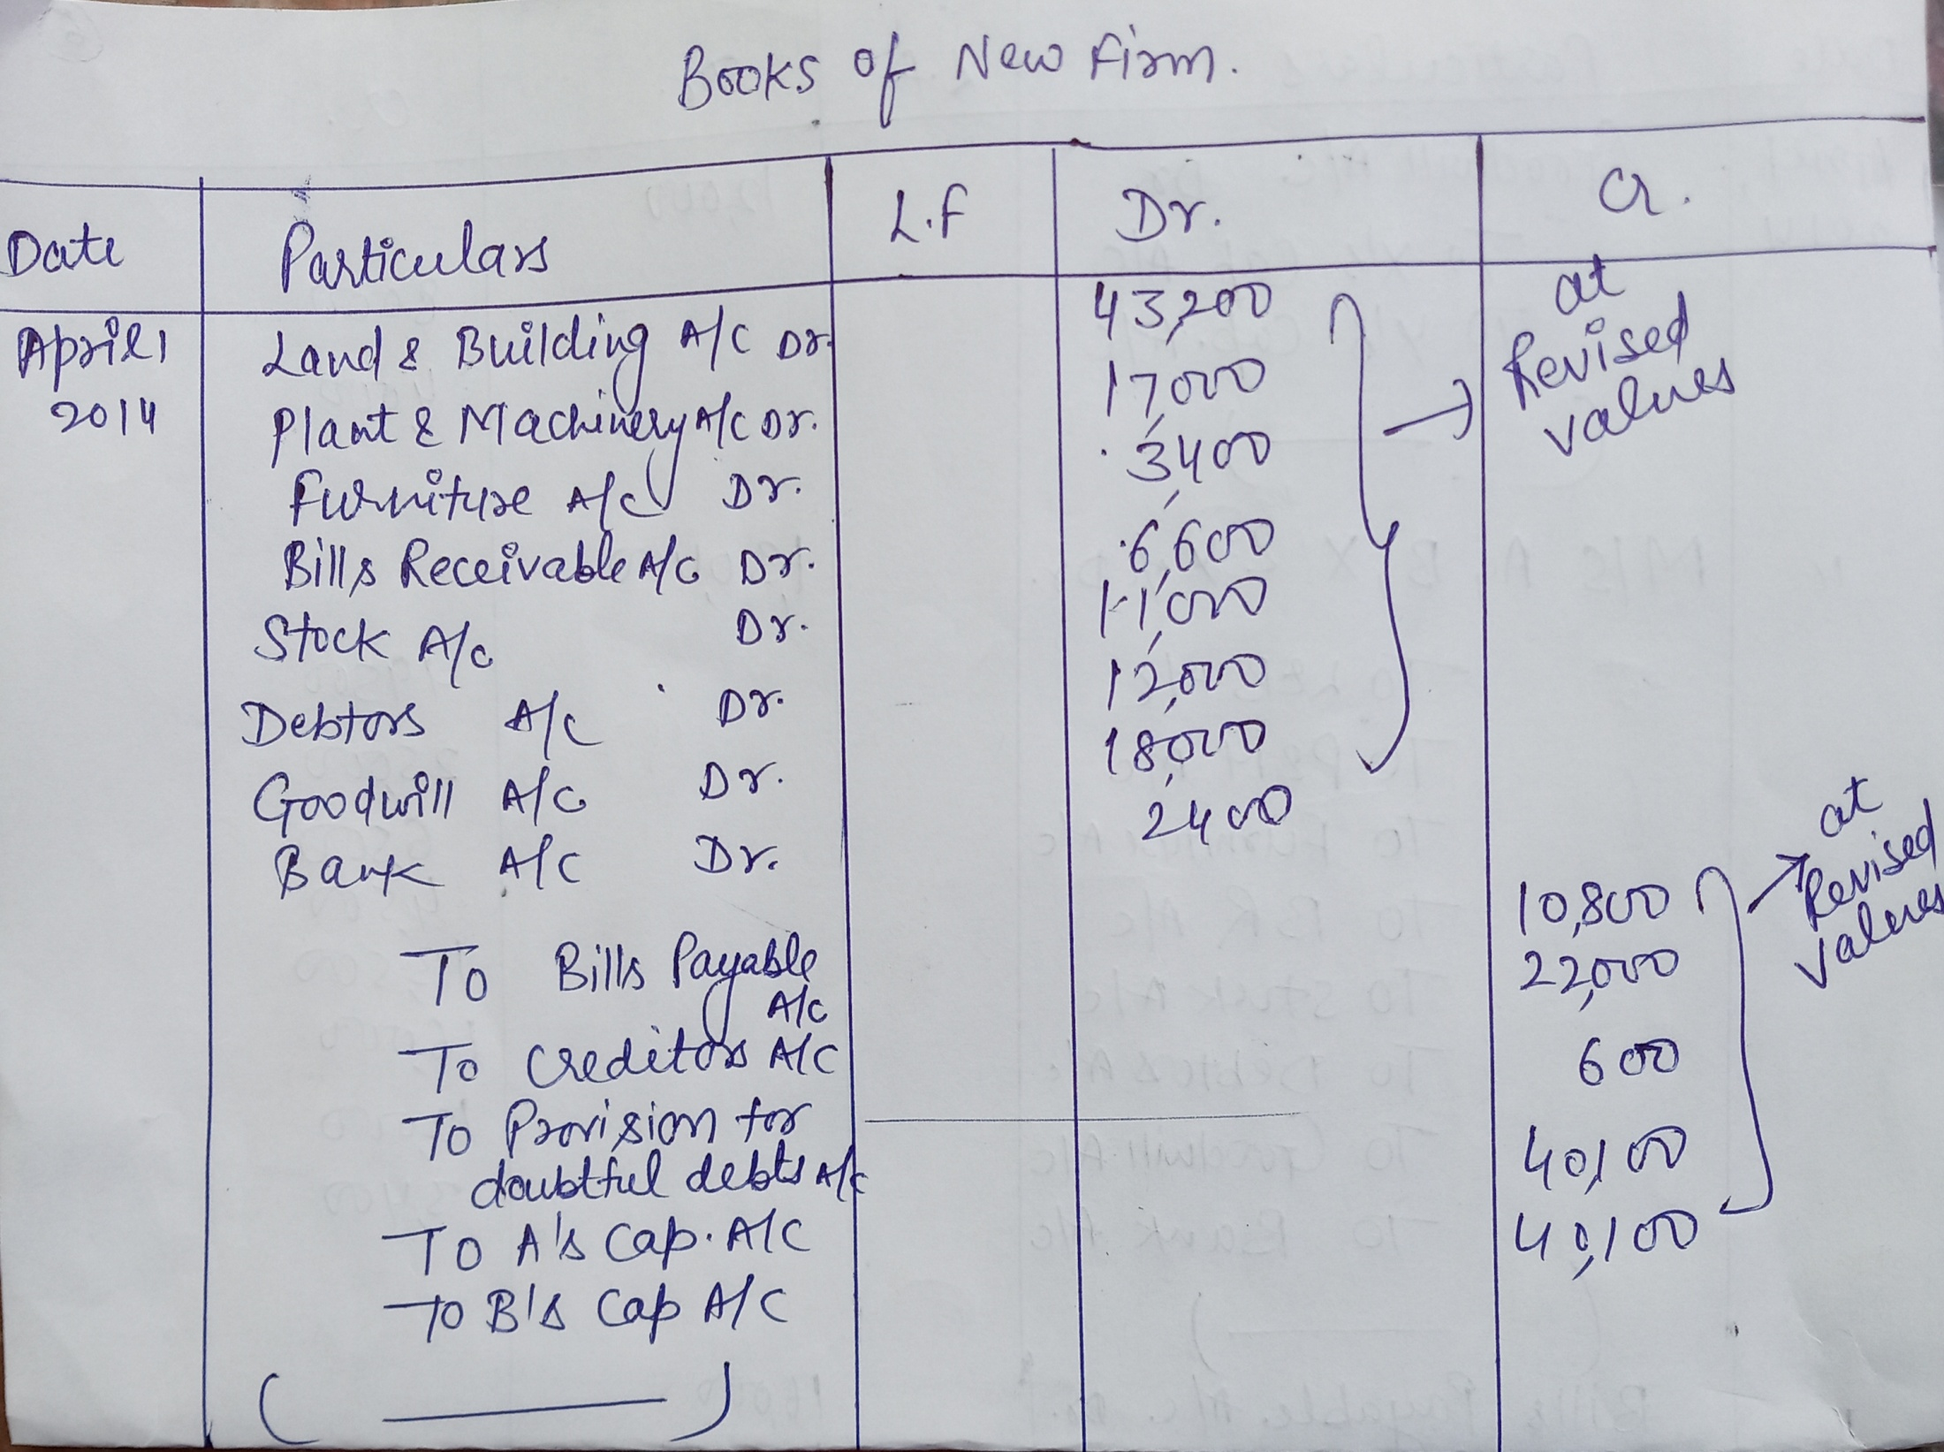

Slide 13
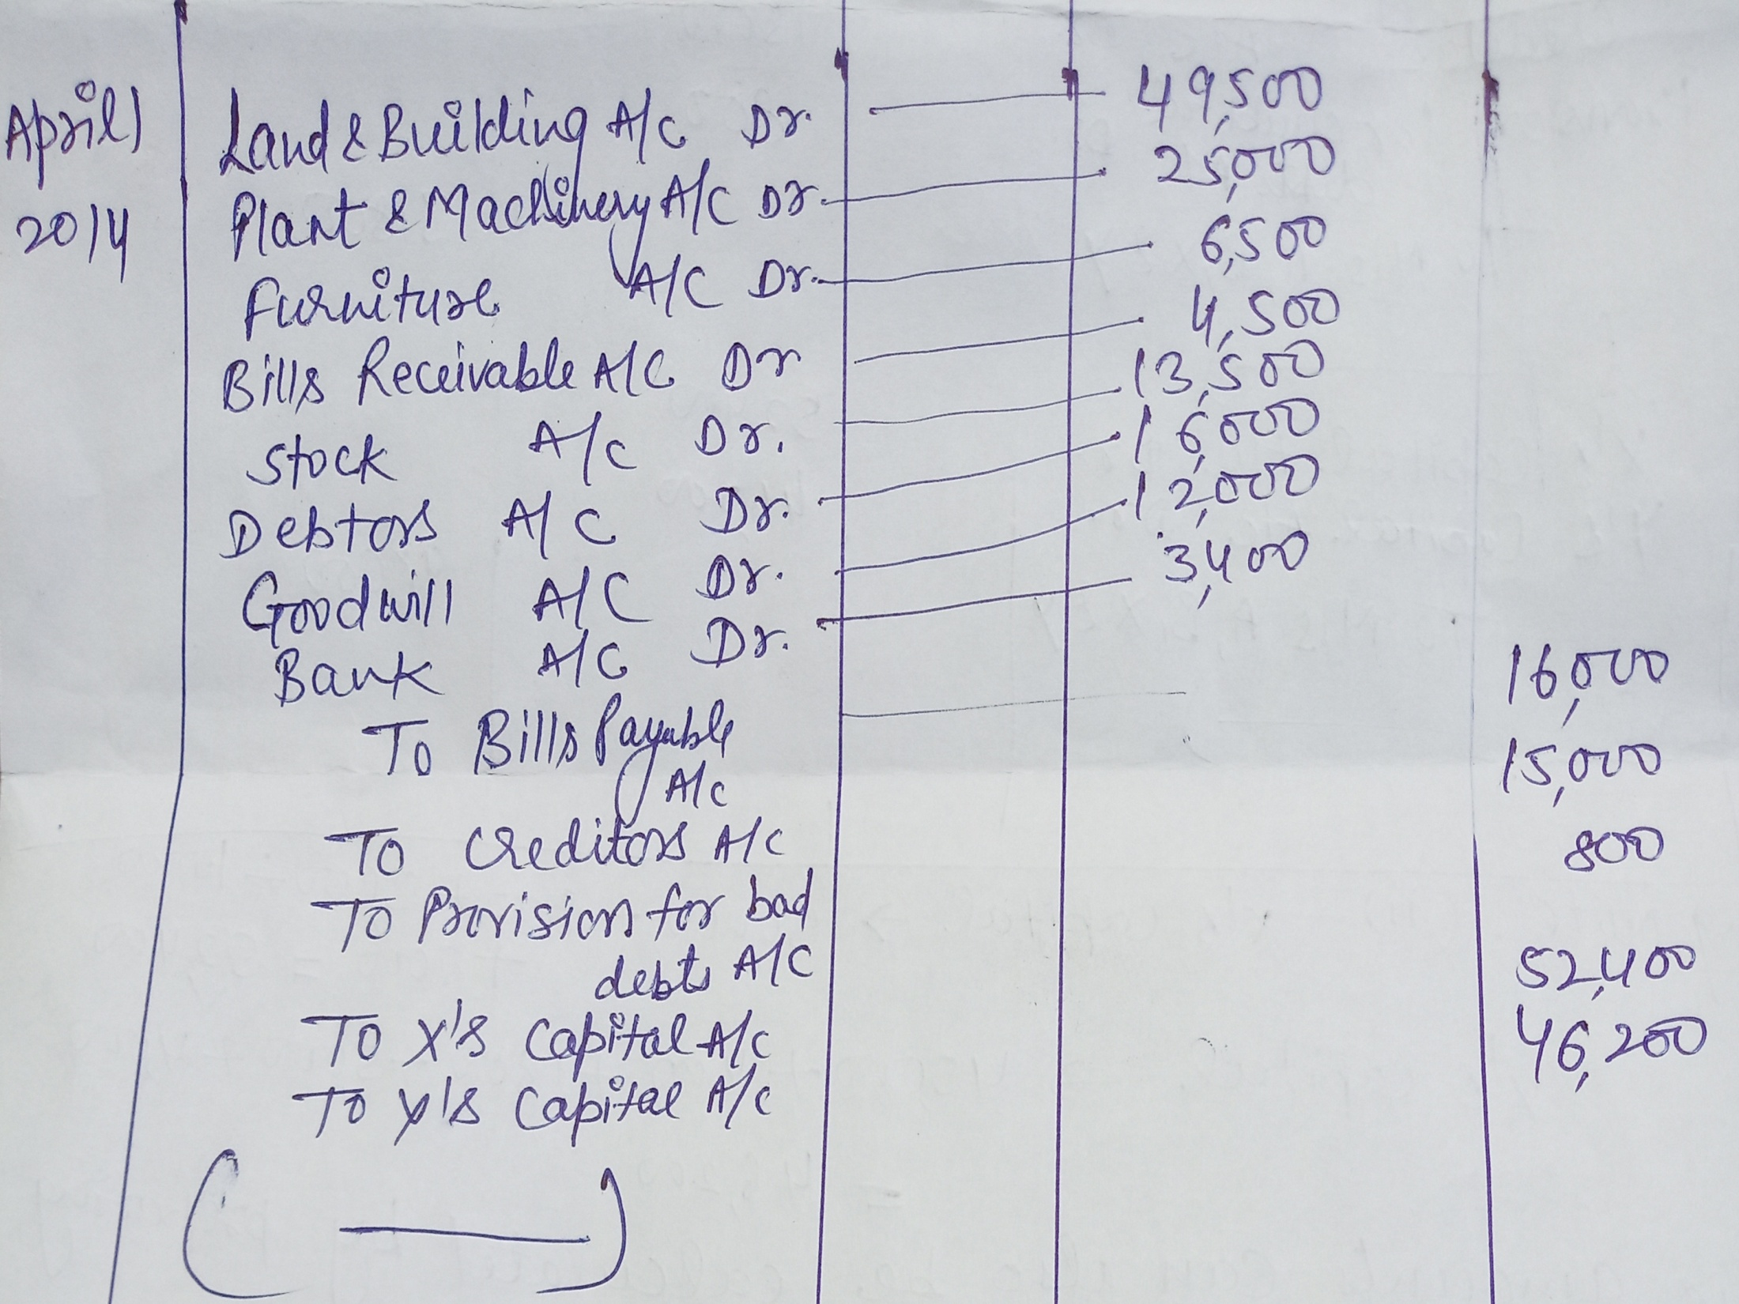

Slide 14
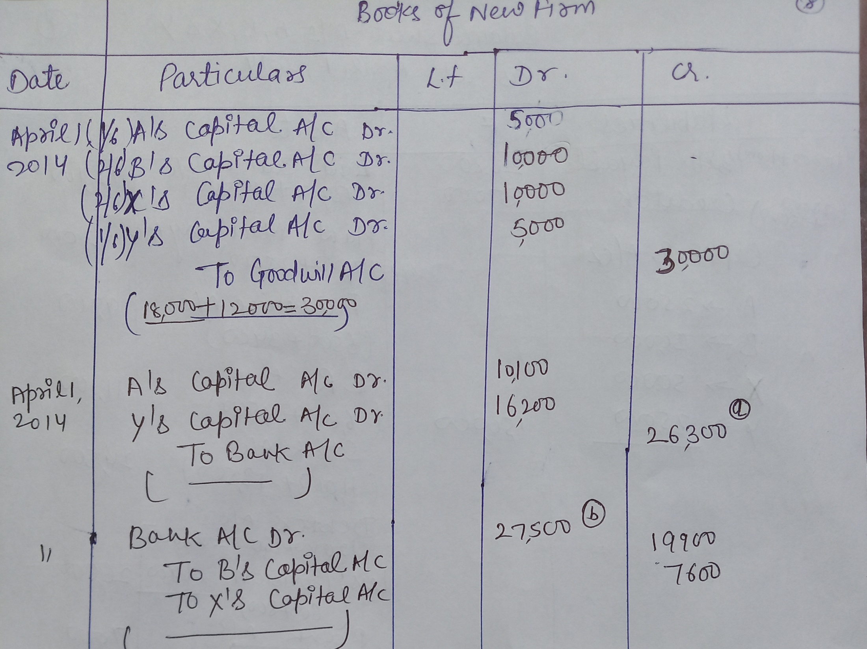

Slide 15
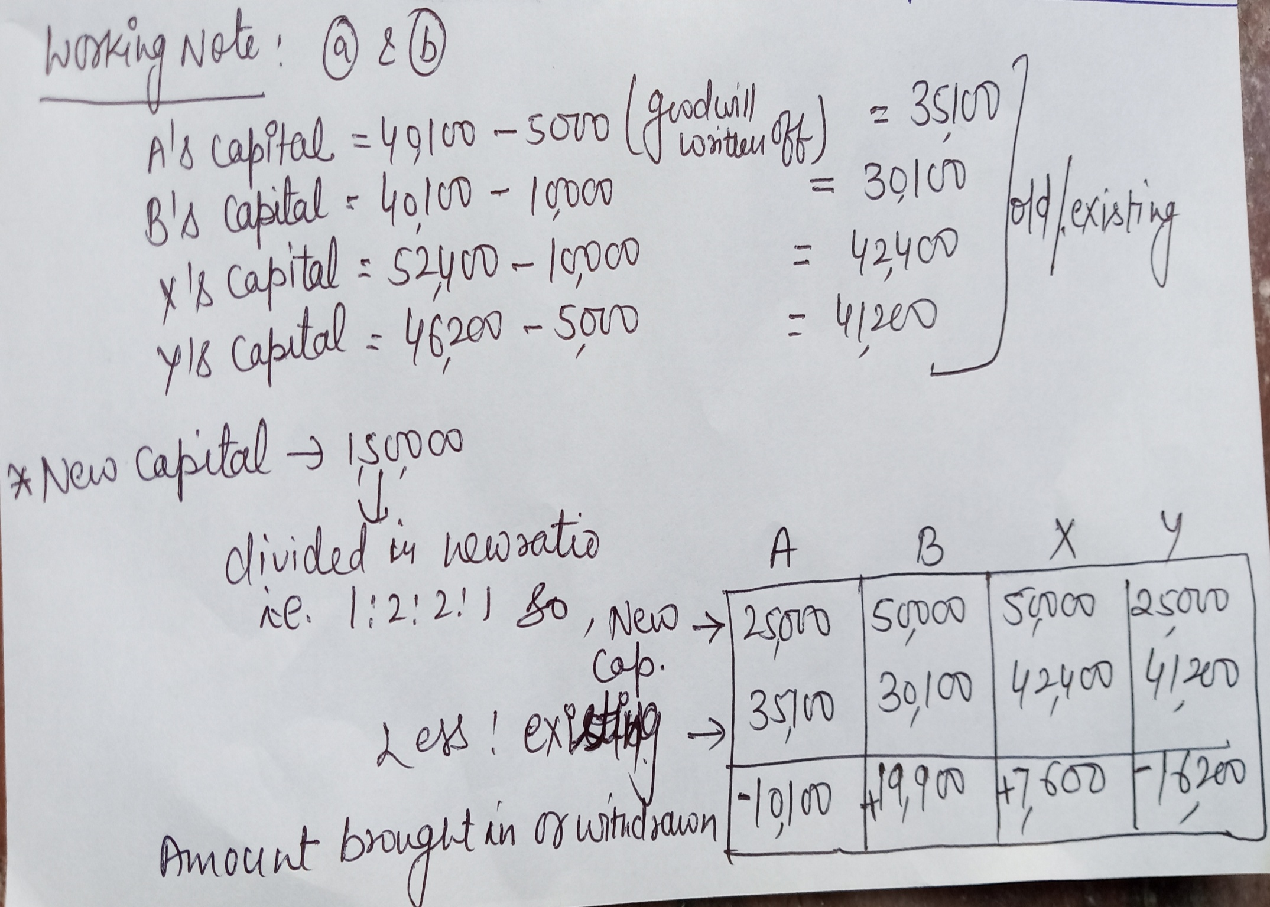

Slide 16
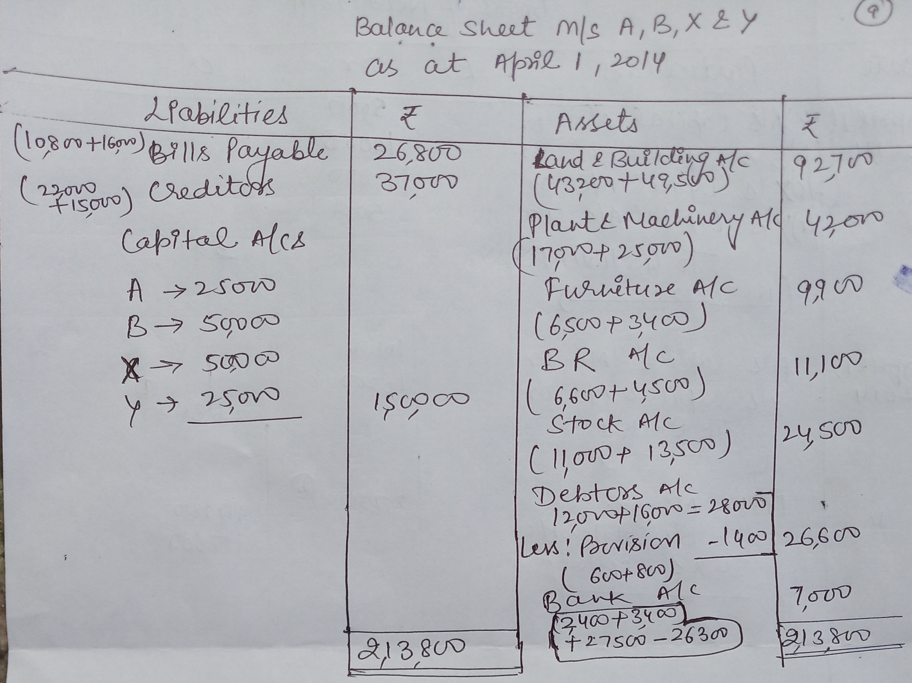

Slide 17
Thanks

